Slide 1

They Slew The Dreamer
MLK
“The Reverend King has been shot…”

Slide 2
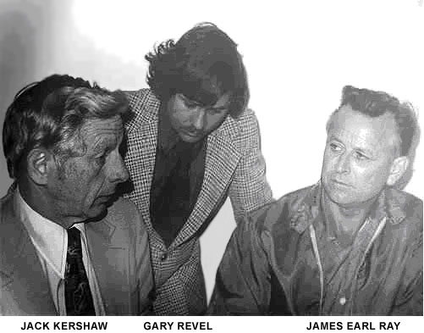
MLK
The Conspiracy to Kill a Dream
A Screenplay by William Sachs
A fact-based and thought-provoking thriller, MLK, is not just a story about the investigation of an assassination; it is also the story about a young man who took a simple part-time job and found himself at the center of one of our history’s major political and social events.

Slide 3
Marketing Note: This movie relates to the hopes, dreams and challenges of all people in this country and around the world.
Logline: Watching the destruction of his dreams became a living nightmare for Gary Revel.
Still, he survived, and this is his story.

Slide 4
“A Lie Cannot Live.” ~Martin Luther King Jr.
Danger and intrigue chased Gary
through his quest for the truth.
They tried to kill the truth,
they tried to destroy all the evidence,
but Gary is living proof and the dream lives on.

Slide 5
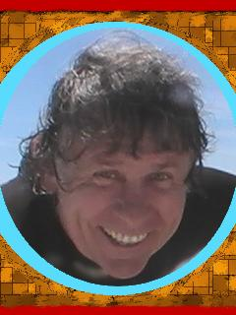
Surviving the cover-up
How far would you go for the Truth?
Gary survived. King’s dream is still alive.
Now is the time for the true story to be told.
Investigating the Cover Up was No Easy Task
When no one believes you
When family members and witnesses begin to drop dead around you
When you begin to question your own sanity
When the Mafia tells you to back off and you won’t
Who can you trust?
No One.
Where can you hide?
Right in front of their faces.

Slide 6
Contact us
Gary Revel Official Website
Gary Revel MLK News Site
Thank you, for more information or if you would like to interview Gary Revel please email us your contact information and you will be put on a waiting list.
Interviews will be scheduled after MLK has been released.
Presentation by Elisabeth Revel
Copyright 2009 by Gary Revel
All Rights Reserved

